Slide 1

Surf Excel “Daag Ache Hai”
Group 9
HAHM23001 Aaditya Chinmay Bade
HAHM23002 Abhishek Dhakad
HAHM23041 Muskan Agarwal
HAHM23062 Satyansh

Slide 2




Introduction
Surf Excel’s “Daag Ache Hai” campaign was launched in 2005 and has been running ever since.
The campaign's tagline, “Daag Ache Hain” simply translates to “Dirt is Good.”
The “Daag Ache Hai” campaign by Surf Excel aims to alter the perception of filth and stains among Indian parents.
The goal of the campaign is to persuade parents to let their kids explore their surroundings and get dirty without worrying about their clothes.

Slide 3
Integrated Marketing Message
Surf Excel uses frequent print media ads as well as prominent television commercials to promote its ATL brand.
Since it's a fast-moving consumer good, there are ongoing marketing campaigns that distribute discounts and offers at various retail locations around India.
Surf Excel uses “Daag Ache Hai” to show it offers outstanding stain removal ability on a wide range of stains.
The campaign tells to not worry about the stains and enjoy the festivals, sports, etc. This is further clubbed to solve the social stigma, showing stains thus caused are good.

Slide 4

1. Psychographic:
Lifestyle: Active, Casual, Fashion-conscious
Personality: Outgoing, Introverted, Family-oriented
Values: Health, Cleanliness, Convenience
2. Behavioral:
Benefits sought: stain removal, Brightness, Fragrance, Softness, Gentle on skin
Usage rate: Heavy users
3. Demographic:
Age: Adults, Seniors
Gender: Majorly Women
Income: Middle income groups
Mothers: They are the primary decision-makers for household products
Families: They are a large market segment with a high demand for laundry detergents.
Urban consumers: They have higher disposable incomes and are more likely to be brand loyal.
Target to Specific Segments with different Sub-brands
Surf Excel for Babies: Mothers of young children.
Surf Excel for Woolens: People who own woolen clothes.
Surf Excel for Colors: People who want to keep their clothes looking new.
Surf Excel positions itself as:
The leading detergent brand in India.
A brand that is trusted by mothers.
A brand that is gentle on clothes and skin.
A brand that offers a wide range of products to meet the needs of different consumers.
Following Support to its Brand Positioning:
Strong brand equity: Surf Excel has been a trusted brand in India for over 60 years.
High-quality products: Surf Excel products are known for their effectiveness and quality.
Corporate social responsibility: Surf Excel is involved in a number of corporate social responsibility initiatives.

Slide 5
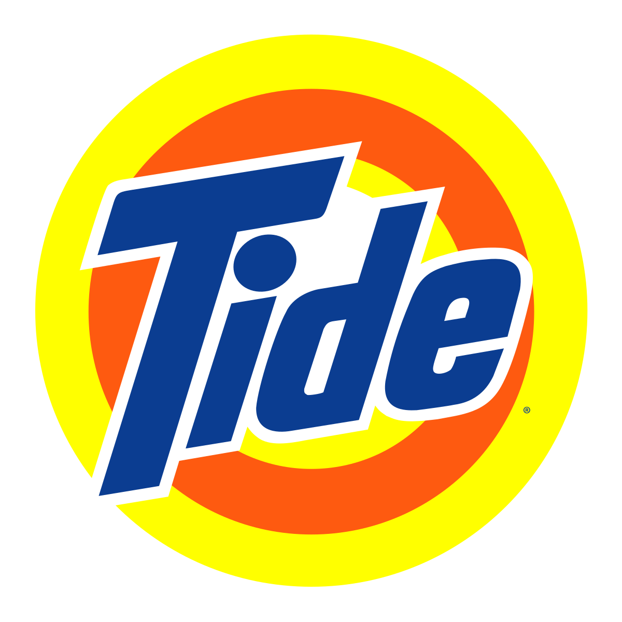

“Chauk gaye” Tide Advertisement Campaign

Slide 6
Integrated Marketing Message
Tide is the trusted laundry solution for families who want to conquer tough stains and keep their clothes looking their best.
With its advanced cleaning technology and unwavering commitment to innovation, Tide delivers the confidence that comes from knowing your clothes are clean and fresh.
“Chauk Gaye” simply translates to “Shocked?”
“Chauk Gaye” marketing campaign by tide aims to deliver the message that it has outstanding ability to clean the hard stains like oils, spice, etc. to maintain the shine of old clothes.

Slide 7
Targeting
Mothers: They mostly perform the laundry task in houses and are the primary decision-makers for household products
Positioning
Cheaper detergent brand in economic market segment
Families: They are a large market segment with a high demand for laundry detergent
A brand that is trusted by mothers
Removes hard stains like oils, spices, etc. and maintains shine of old clothes like a new one

Slide 8


“Share the Load” Ariel Advertisement Campaign

Slide 9
Integrated Marketing Message
The “Share the Load” campaign is engaging because it addresses a relatable issue faced by many households. By tackling this common problem, the campaign creates a connection with the audience and encourages them to reflect on their own experiences.
The message of the campaign is consistent with Ariel’s brand story of making life easier for its consumers, as promoting gender equality and encouraging men to take on more household chores make the home environment a more harmonious place.
The impact of the campaign has been significant, with its powerful message being shared widely and inspiring change.

Slide 10
Targeting
Working professionals: Individuals with busy lifestyles who value convenience and efficiency.
Positioning
A brand that is customer centric, socially aware and non-biased towards roles and contribution by men and women.
Quality-conscious consumers: Individuals who are willing to pay a premium for high-performance laundry products.
A brand that delivers superior stain removal and long-lasting freshness.
A brand that is gentle on clothes and colors.
A brand that is innovative and constantly evolving to meet the needs of consumers.
A brand that is committed to sustainability and environmental responsibility.

Slide 11
Point of Differences
 | Surf Excel | Tide | Ariel
Price per KG | ₹134 | ₹124 | ₹250
Parent Company | Hindustan Unilever | P&G | P&G
Contains Bleach | No | No | Yes
Market Share | 43% | 13.5% | 1.5%
Core Essence | Family based detergent | Innovative laundry detergent | Regular stain remover
Brand personality | Middle income group | Lower to middle income group | High income group
Emotional benefits | Daag acche hai | Caring, gentle, nostalgia | Ground to earth, family values
Product benefits | Not harmful for hands | Best hand washing results | Less water benefits, gentle on clothes and hands
Product attributes | Natural ingredients | Good quality, lower price, best whitening | Superior tech, quality, trust

Slide 12
Thank you

